Slide 1
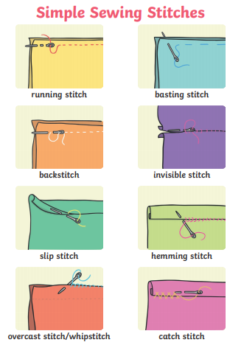
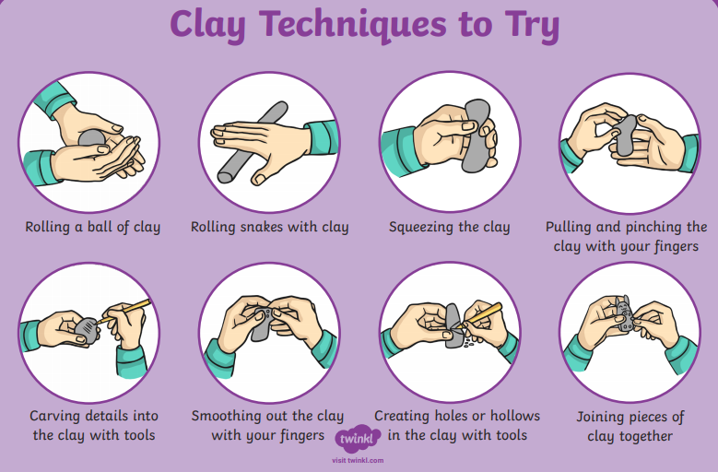
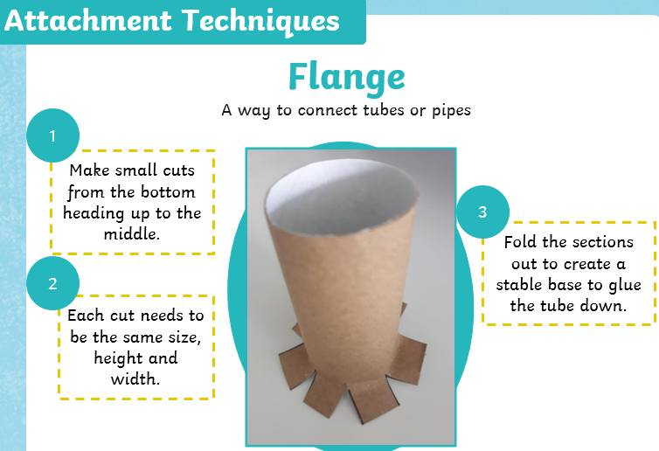
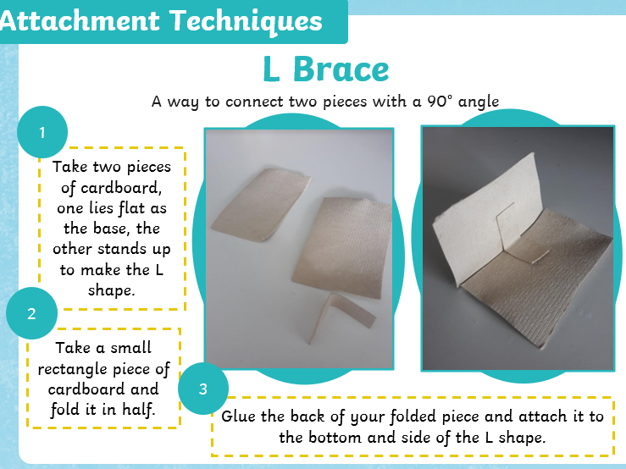
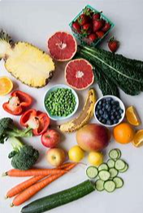
Whitley Abbey Primary School
Hand in Hand We Learn
Knowledge Organiser - DT - Key stage 1
Key Vocabulary ​
Evaluate - is a test used to compare an object against requirements and specifications.
Product - an article or substance that is manufactured or refined for sale.
Design - a plan or drawing produced to show the look and function or workings of a building, garment, or other object before it is made.
Ornamentation - decorative elements added to something to enhance its appearance.
View Finder

Slide 2
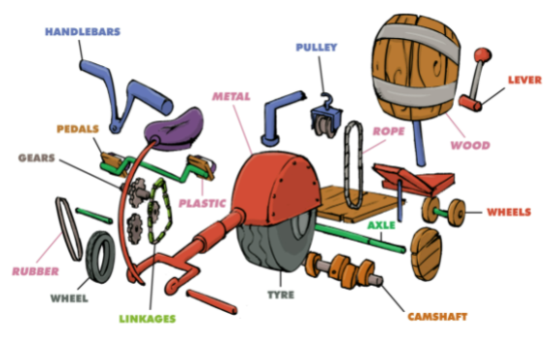
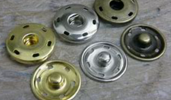
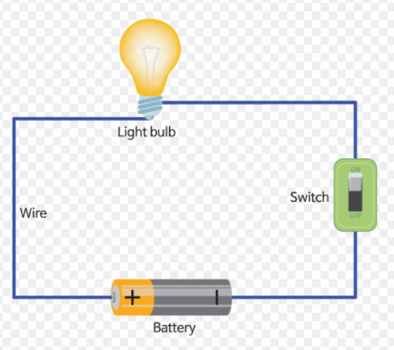
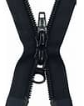
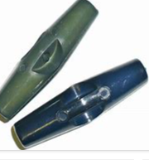
Whitley Abbey Primary School
Hand in Hand We Learn
Knowledge Organiser - DT - Lower Key Stage 2
Key Vocabulary ​
Evaluate - is a test used to compare an object against requirements and specifications.
Product - an article or substance that is manufactured or refined for sale.
Design - a plan or drawing produced to show the look and function or workings of a building, garment, or other object before it is made.
Ornamentation - decorative elements added to something to enhance its appearance.
Aesthetics - are the features that customers/users like and dislike about the sensual appearance of a product.
View Finder
Exploded diagram

Slide 3
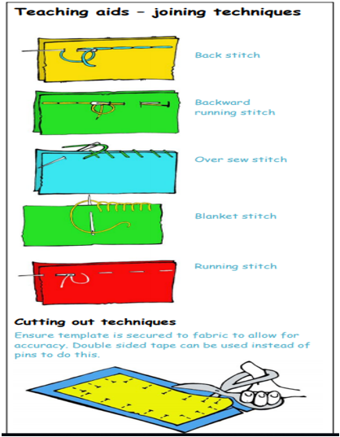
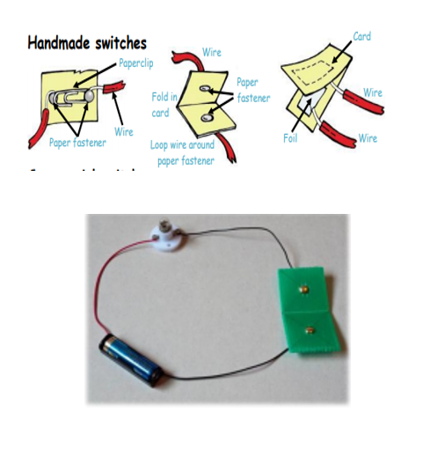
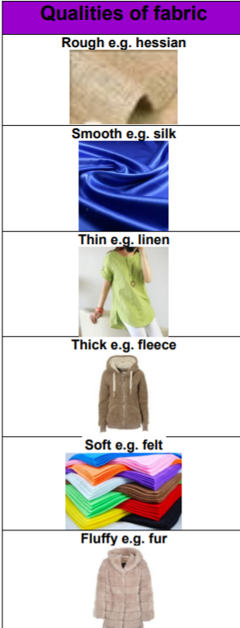
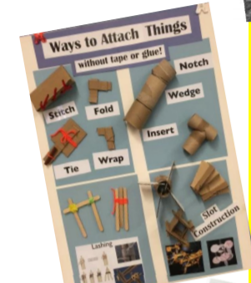
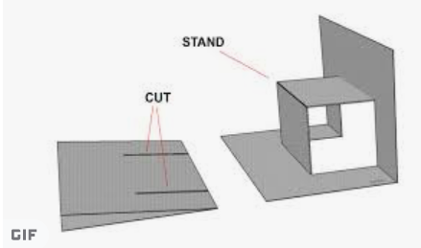
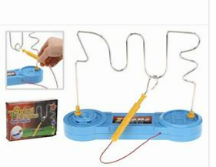
Whitley Abbey Primary School
Hand in Hand We Learn
Knowledge Organiser - DT - Upper Key stage 2
Key Vocabulary ​
Evaluate - is a test used to compare an object against requirements and specifications.
Product - an article or substance that is manufactured or refined for sale.
Design - a plan or drawing produced to show the look and function or workings of a building, garment, or other object before it is made.
Ornamentation - decorative elements added to something to enhance its appearance.
Aesthetics - are the features that customers/users like and dislike about the sensual appearance of a product.

