Slide 2
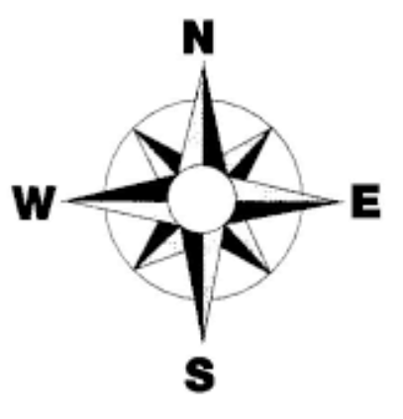
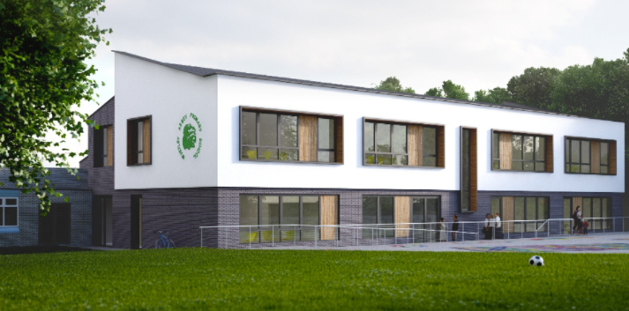
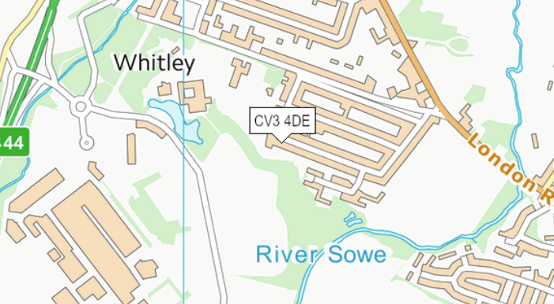
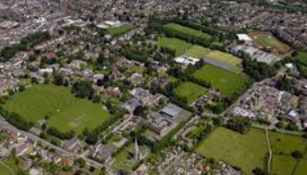
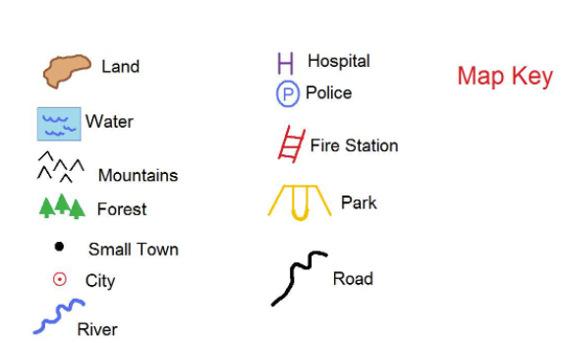
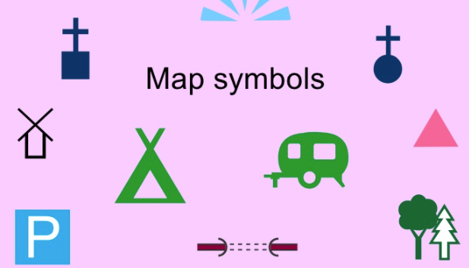
Whitley Abbey Primary School
Hand in Hand We Learn
Knowledge Organiser - Geography – School Locality
Compass
Key Vocabulary
Local area – The area around an identified point.
Land Use-is the function of land – what it is used for.
Aerial View-any view from a great height, above.
Symbol-a thing that represents or stands for something else.
Key- a list of symbols that appear on the map
Field--an area of open land, especially one planted with crops or pasture, typically bounded by hedges or fences.
Path-a way or track laid down for walking or made by continual treading.
Playground-an outdoor area provided for children to play in, especially at a school or public park.
Map - a diagrammatic representation of an area of land or sea showing physical features, cities, roads, etc.
Spinning top
Map
Aerial View
key

Slide 3
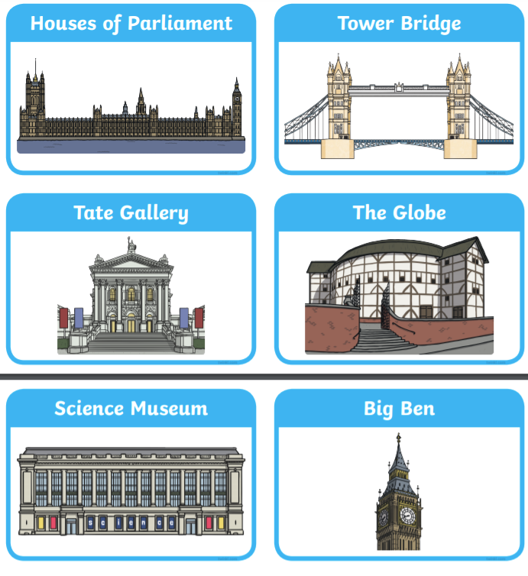
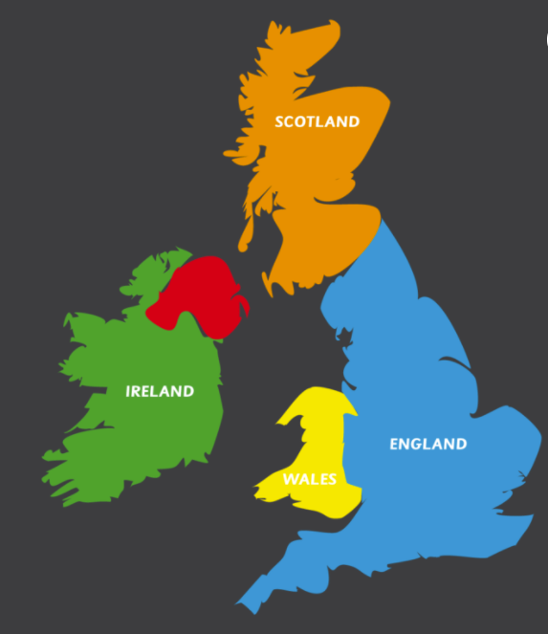
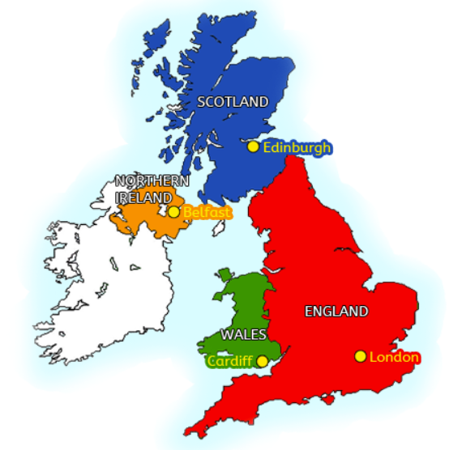
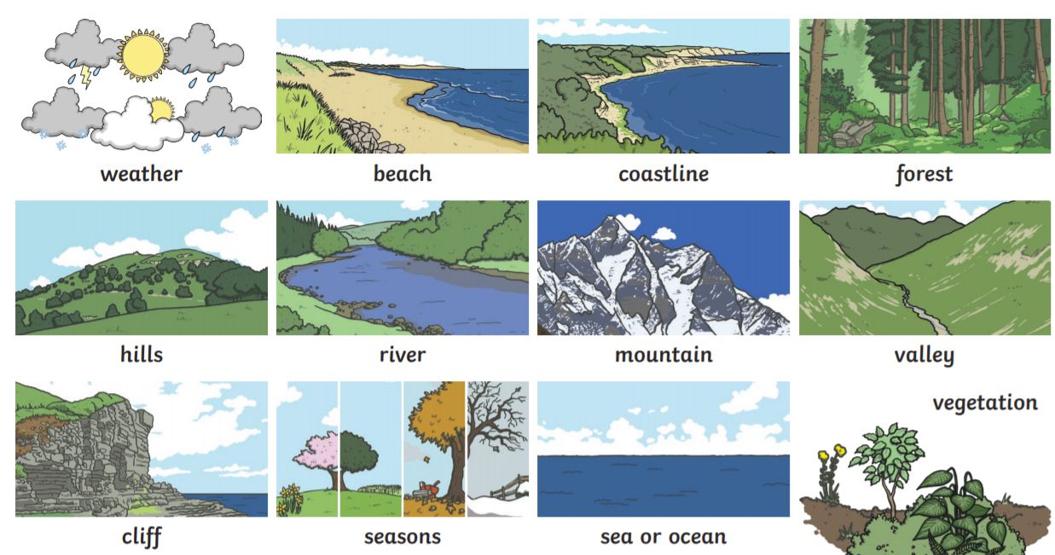
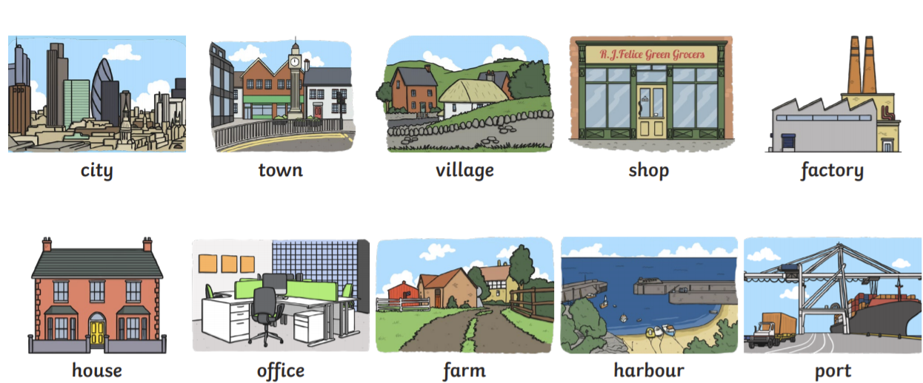
Whitley Abbey Primary School
Hand in Hand We Learn
Knowledge Organiser - Geography – London and UK
Compass
Key Vocabulary
Capital City– the city or town that functions as the seat of government and administrative centre of a country or region.
Landmarks-an object or feature of a landscape or town that is easily seen and recognized from a distance, especially one that enables someone to establish their location.
Aerial View-any view from a great height, above.
Human Features - like houses, roads and bridges are things that have been built by people.
Physical Features - Physical features like seas, mountains and rivers are natural. They would be here even if there were no people around.
Map - a diagrammatic representation of an area of land or sea showing physical features, cities, roads, etc.
Aerial View
Landmarks
Map of UK
Physical Features
Human Features
Capital Cities

Slide 4
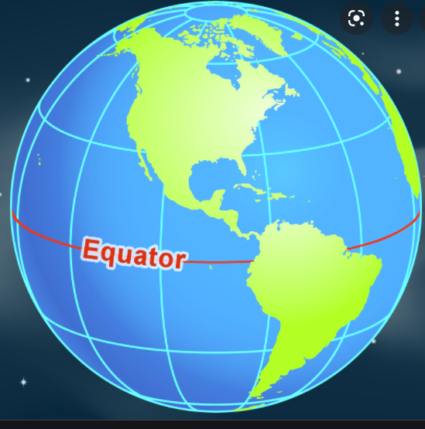
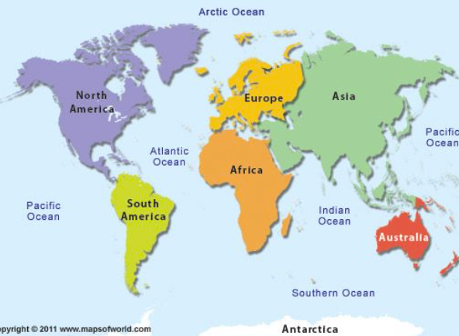
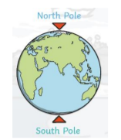
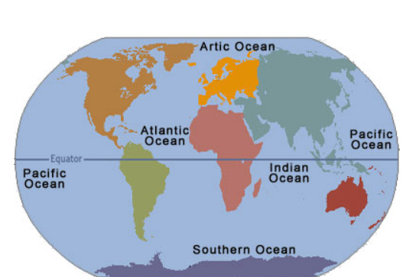
Whitley Abbey Primary School
Hand in Hand We Learn
Knowledge Organiser - Geography – Hot and Cold Places
Compass
Key Vocabulary
Human Features - like houses, roads and bridges are things that have been built by people.
Physical Features - Physical features like seas, mountains and rivers are natural. They would be here even if there were no people around.
Map - a diagrammatic representation of an area of land or sea showing physical features, cities, roads, etc.
Continent - any of the world's main continuous expanses of land (Europe, Asia, Africa, North and South America, Australia, Antarctica).
An equator is an imaginary line around the middle of a planet. It is halfway between the North Pole and the South Pole.
7 Continents
Globe
Physical Features
Human Features
Oceans

Slide 5
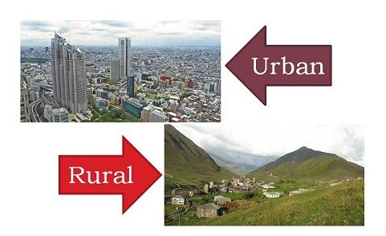
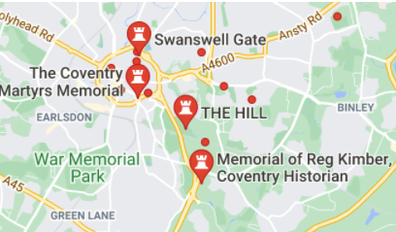
Whitley Abbey Primary School
Hand in Hand We Learn
Knowledge Organiser - Geography – Whitley Area
Compass
Key Vocabulary ​
Local area – The area around an identified point. ​
Land Use-is the function of land – what it is used for. ​
Aerial View-any view from a great height, above.​
Symbol-a thing that represents or stands for something else.​
Key- a list of symbols that appear on the map​
City - a large town . City status in the UK can be associated with having a cathedral or a university, a particular form of local government, or having a large population.
Town - a built-up area with a name, defined boundaries, and local government, that is larger than a village and generally smaller than a city.
Village - group of houses and associated buildings, larger than a hamlet and smaller than a town, situated in a rural area
Map - a diagrammatic representation of an area of land or sea showing physical features, cities, roads, etc.​
​

Slide 6
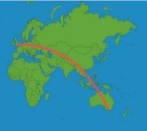
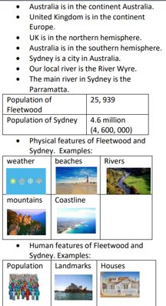
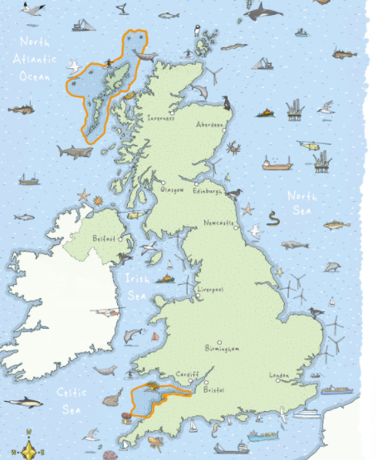
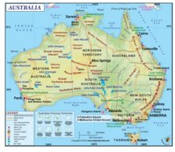
Whitley Abbey Primary School
Hand in Hand We Learn
Knowledge Organiser - Geography – Oceans/Australia
Key Vocabulary ​
Local area – The area around an identified point. ​
Land Use-is the function of land – what it is used for. ​
Aerial View-any view from a great height, above.​
Symbol-a thing that represents or stands for something else.​
Key- a list of symbols that appear on the map​
City - a large town . City status in the UK can be associated with having a cathedral or a university, a particular form of local government, or having a large population.
Sea - the expanse of salt water that covers most of the earth's surface and surrounds its land masses
Ocean - a very large expanse of sea, in particular each of the main areas into which the sea is divided geographically.
Capital City - he city or town that functions as the seat of government and administrative centre of a country or region.
Map - a diagrammatic representation of an area of land or sea showing physical features, cities, roads, etc.​
​Urban - in, relating to, or characteristic of a town or city.
Oceans
Human Features
Physical Features

Slide 7
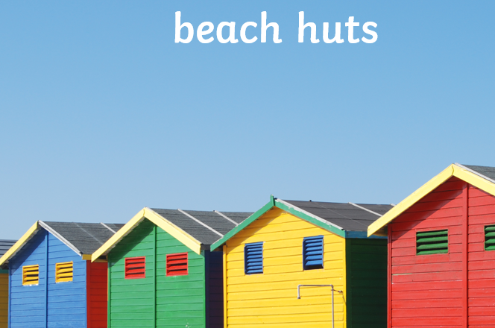
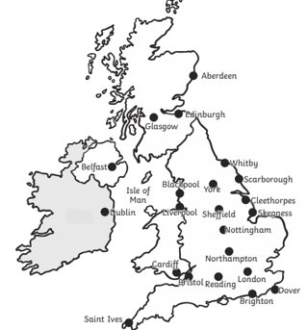
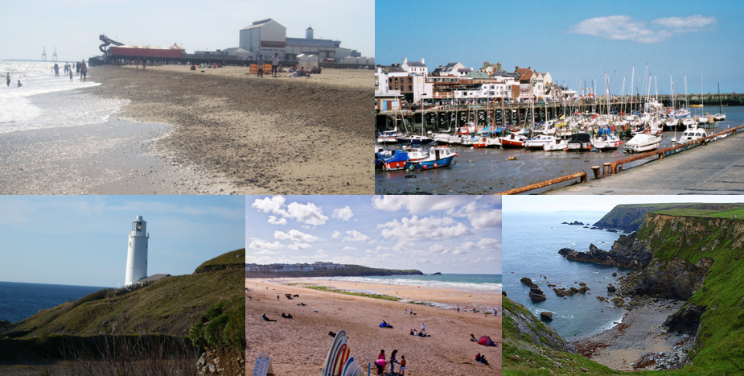
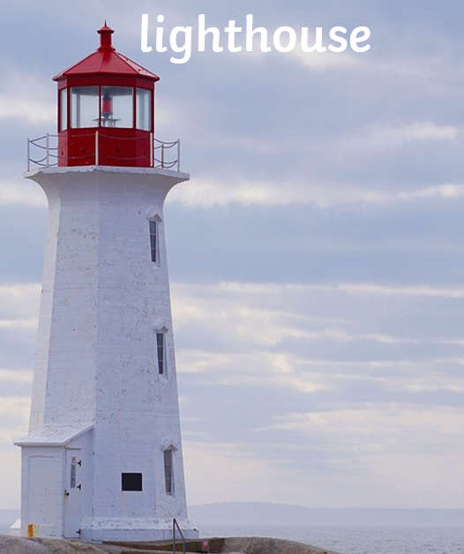
Whitley Abbey Primary School
Hand in Hand We Learn
Knowledge Organiser - Geography – Coastal
Key Vocabulary ​
Human Features - like houses, roads and bridges are things that have been built by people.
Physical Features - Physical features like seas, mountains and rivers are natural. They would be here even if there were no people around.
Peir- a platform on pillars projecting from the shore into the sea, typically incorporating entertainment arcades and places to eat.
Promenade-a paved public walk, typically one along the seafront at a resort.
Environment - he natural world, as a whole or in a particular geographical area, especially as affected by human activity.
Sea - the expanse of salt water that covers most of the earth's surface and surrounds its land masses
Ocean - a very large expanse of sea, in particular each of the main areas into which the sea is divided geographically.
Coast- the part of the land adjoining or near the sea
Map - a diagrammatic representation of an area of land or sea showing physical features, cities, roads, etc.​
Compass
Oceans
Atlantic Ocean
Physical Features
Human Features
Seaside resorts

Slide 8
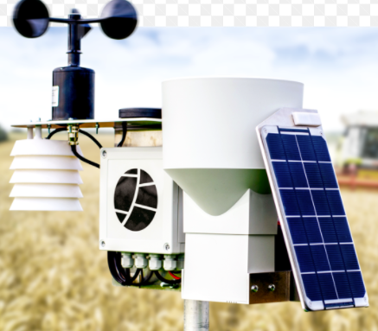
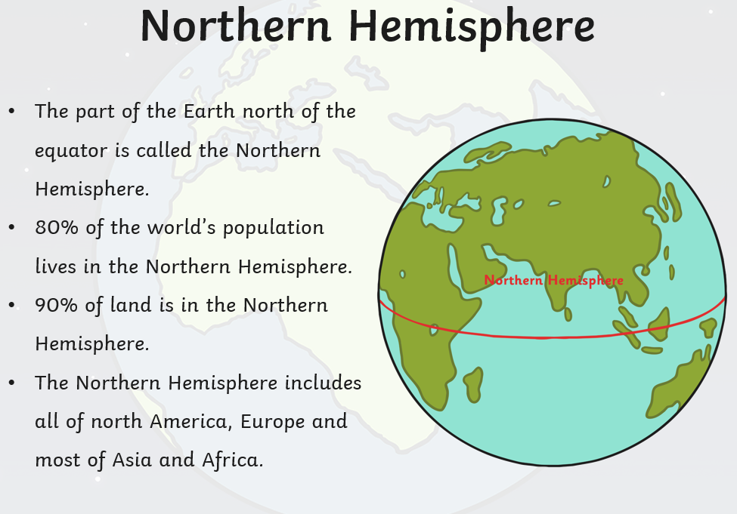
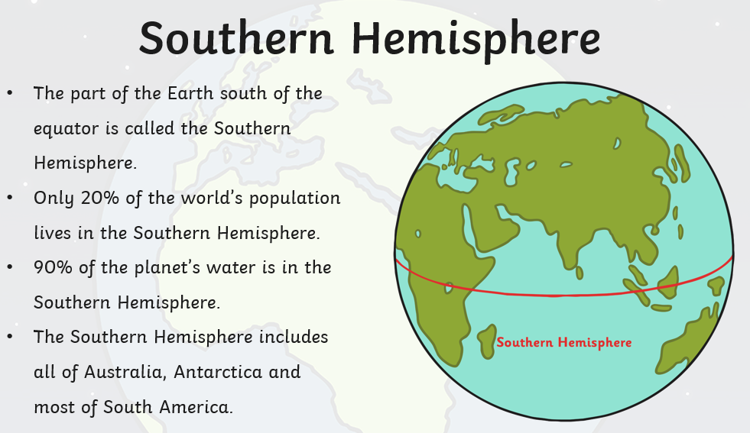
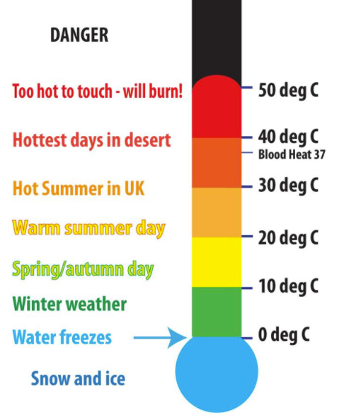
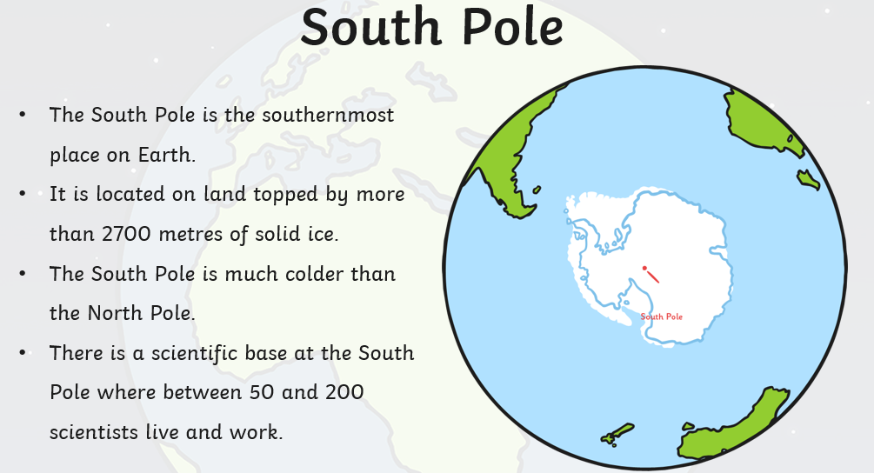
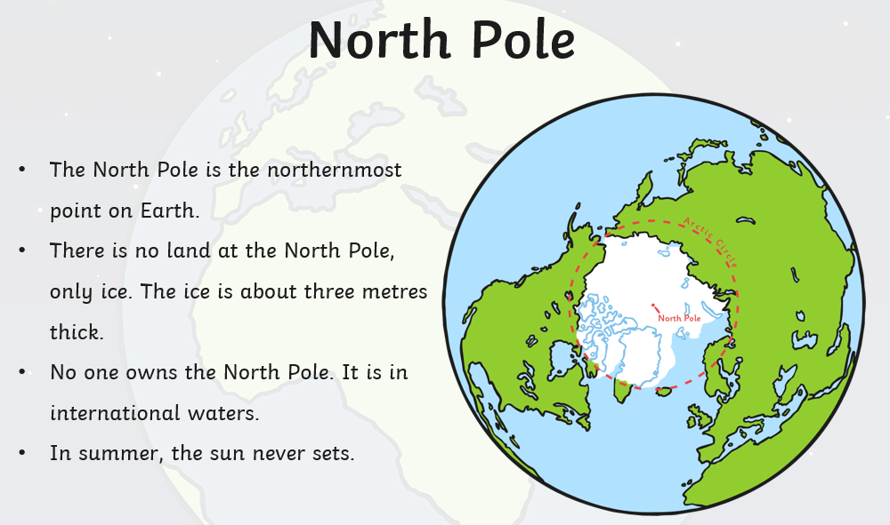
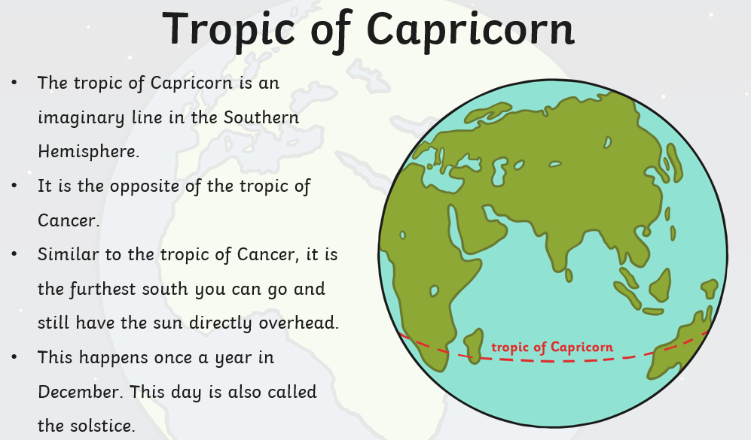
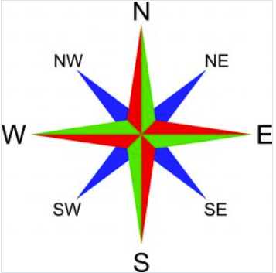
Whitley Abbey Primary School
Hand in Hand We Learn
Knowledge Organiser - Geography – Climate Zones
Key Vocabulary ​
Climate-the weather conditions prevailing in an area in general or over a long period.
Meteorologist - an expert in or student of meteorology; a weather forecaster.
Precipitation - ain, snow, sleet, or hail that falls to or condenses on the ground.
Weather - the state of the atmosphere at a particular place and time as regards heat, cloudiness, dryness, sunshine, wind, rain,
Climate Zone - a world area or region distinguished from a neighbor by a major physical climatic characteristic that is of global scale.
Lattitude -the angular distance of a place north or south of the earth's equator
Longitude - the angular distance of a place east or west of the Greenwich meridian
Equator - is an imaginary line around the middle of a planet. It is halfway between the North Pole and the South Pole.
Season - each of the four divisions of the year (spring, summer, autumn, and winter) marked by particular weather patterns and daylight hours.
Tropical - the warm, hot areas located between the Tropic of Cancer and the Tropic of Capricorn.
Arid - having little or no rain; too dry or barren to support vegetation
Polar - elating to the North or South Pole.
Mediterranean climate - dry summer climate is characterized by dry summers and mild, wet winters.
Weather Station
Oceans
Physical Features
Human Features

Slide 9
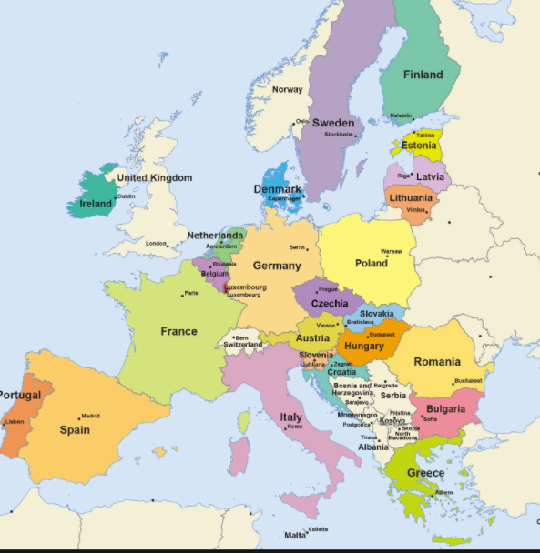
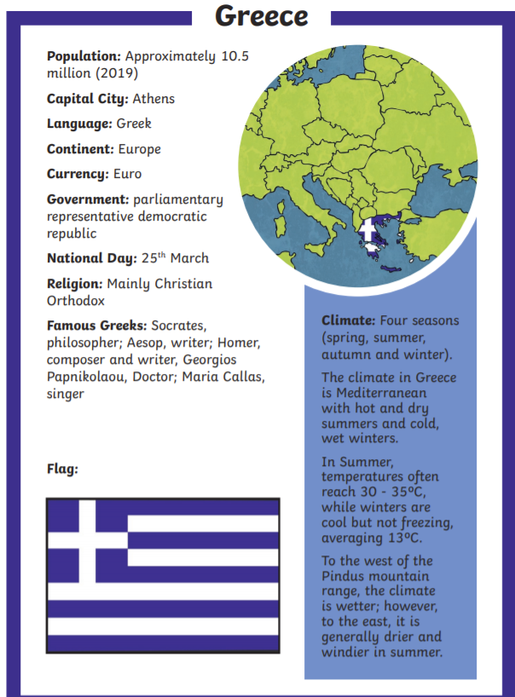
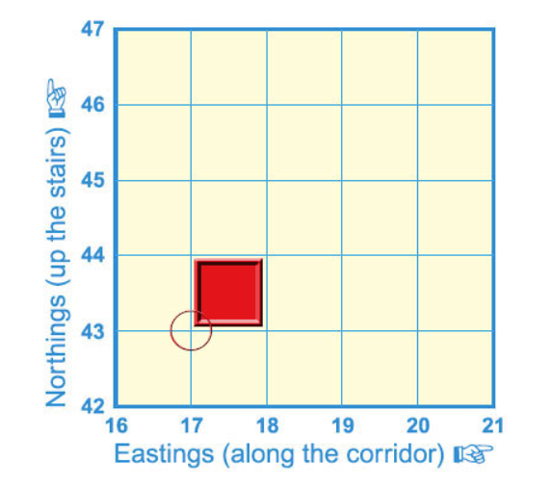
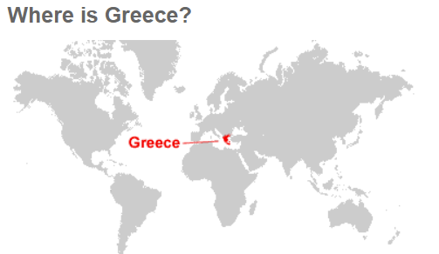
Whitley Abbey Primary School
Hand in Hand We Learn
Knowledge Organiser - Geography – Our Continent
Key Vocabulary ​
Climate-the weather conditions prevailing in an area in general or over a long period.
Landmass -a continent or other large body of land.
Border -A border is a real or artificial line that separates geographic areas.
Region -an area, especially part of a country or the world having definable characteristics but not always fixed boundaries
Population - all the inhabitants of a particular place
Inhabitants –a person or animal that lives in or occupies a place
Tourists – visitors to a place – holidaymakers or sightseers.
Economy -the state of a country or region in terms of the production and consumption of goods and services and the supply of money.
Mediterranean climate - dry summer climate is characterized by dry summers and mild, wet winters.
Oceans
Physical Features
Human Features

Slide 10
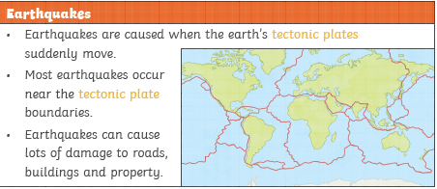
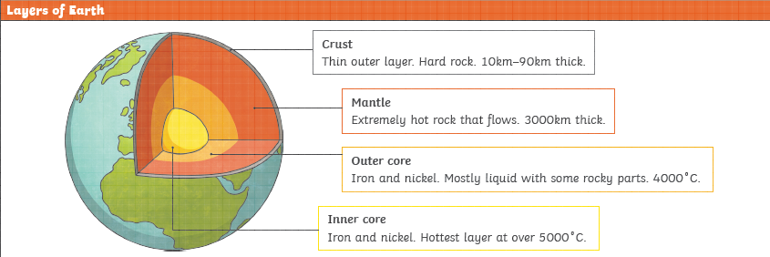
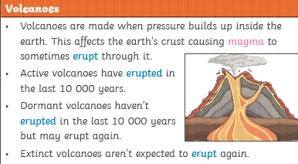
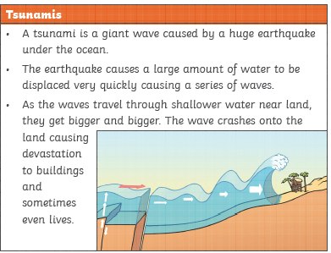
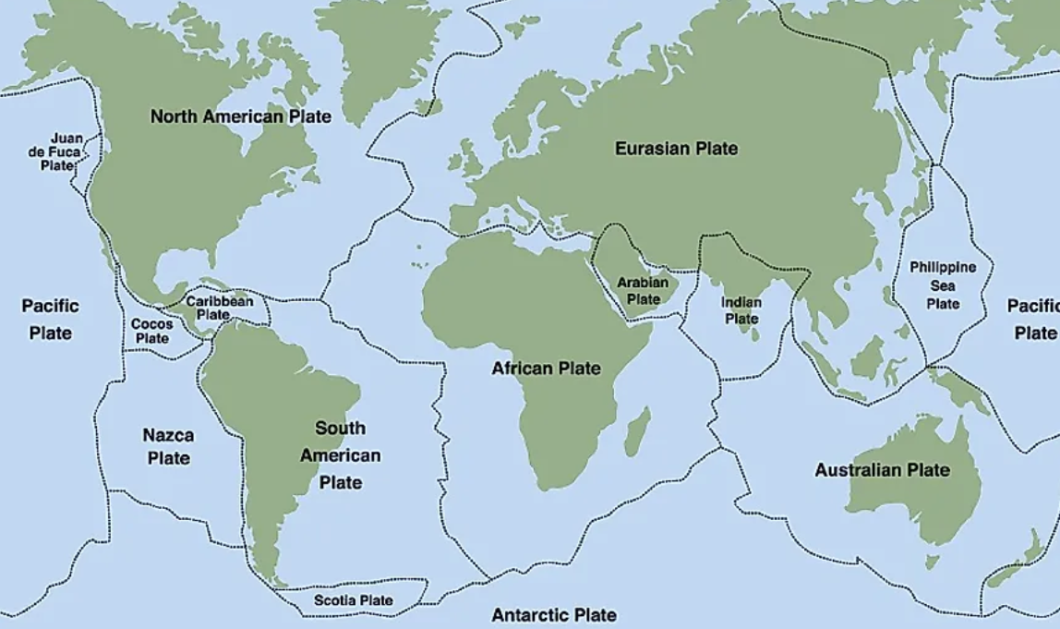
Whitley Abbey Primary School
Hand in Hand We Learn
Knowledge Organiser - Geography – Tremors
Key Vocabulary ​
Erupt - (of a volcano) become active and eject lava, ash, and gases
Dormant -volcanoes have not erupted for a very long time but may erupt at a future time.
Extinct - volcanoes that are not expected to erupt in the future.
Magnitude - the great size or extent of something
Aftershock - a smaller earthquake following the main shock of a large earthquake
Ash cloud - a violent explosive eruption ejects volcanic ash into the atmosphere
Lava - hot molten or semi-fluid rock erupted from a volcano or fissure, or solid rock resulting from cooling of this
Tremor - slight earthquake
Epicentre - the point on the earth's surface vertically above the focus of an earthquake
Vent - opening that allows air, gas, or liquid to pass out of or into a confined space

Slide 11
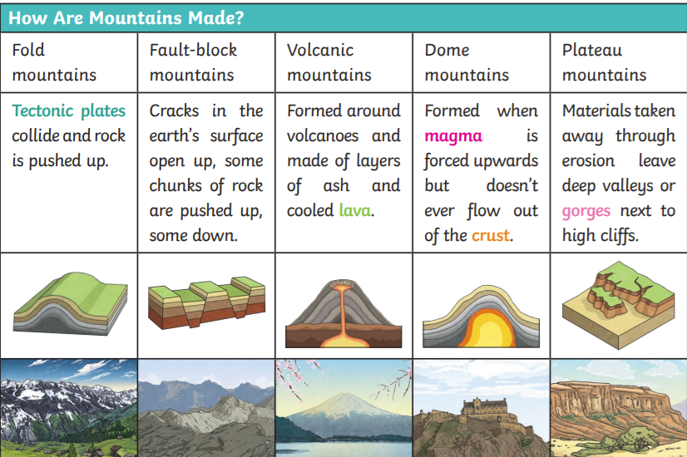
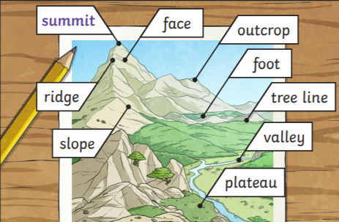
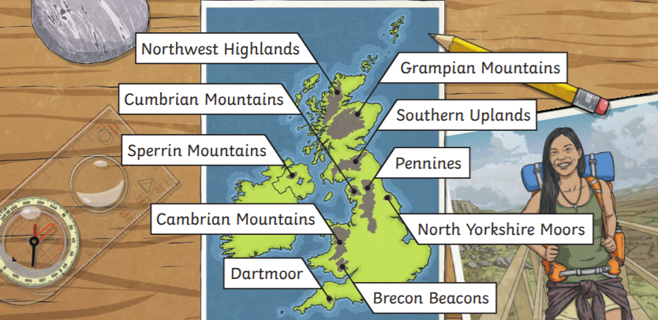
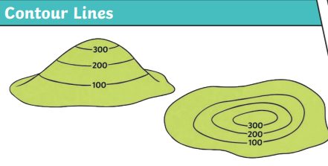
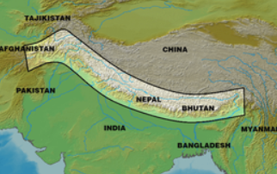
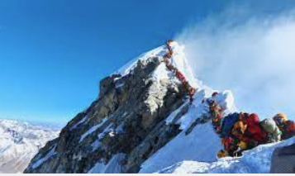
Whitley Abbey Primary School
Hand in Hand We Learn
Knowledge Organiser - Geography – Mountains
Key Vocabulary ​
Mountain - large natural elevation of the earth's surface rising abruptly from the surrounding level; a large steep hill.
Hill-a naturally raised area of land, not as high or craggy as a mountain.
Peak - he pointed top of a mountain.
Landform - natural feature of the earth's surface.
Avalanche - mass of snow, ice, and rocks falling rapidly down a mountainside
Ash cloud - a violent explosive eruption ejects volcanic ash into the atmosphere
An equator is an imaginary line around the middle of a planet. It is halfway between the North Pole and the South Pole.
Himalayas - re a mountain range in South and East Asia separating the plains of the Indian subcontinent from the Tibetan Plateau. The range has many of Earth's highest peaks, including the highest, Mount Everest, at the border between Nepal and China.

Slide 12
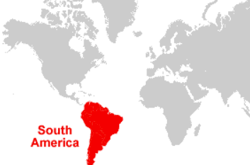
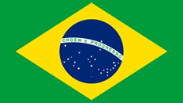
Whitley Abbey Primary School
Hand in Hand We Learn
Knowledge Organiser - Geography – South America
Key Vocabulary ​
Continent - any of the world's main continuous expanses of land (Europe, Asia, Africa, North and South America, Australia, Antarctica).
Landmass -a continent or other large body of land.
Landlocked - (of a country or region) almost or entirely surrounded by land.
Colony - a group of people of one nationality or race living in a foreign place.
Time-zone - a range of longitudes where a common standard time is used.
An equator is an imaginary line around the middle of a planet. It is halfway between the North Pole and the South Pole.
Indigenous -originating or occurring naturally in a particular place; native
Population - all the inhabitants of a particular place
Mining - the process or industry of obtaining coal or other minerals from a mine
Trade - the action of buying and selling goods and services.

Slide 13
Whitley Abbey Primary School
Hand in Hand We Learn
Knowledge Organiser - Geography – Rainforests
A biome is a large community of vegetation and wildlife adapted to a specific climate. The five major types of biomes are aquatic, grassland, forest, desert, and tundra.
Key Vocabulary ​
Continent - any of the world's main continuous expanses of land (Europe, Asia, Africa, North and South America, Australia, Antarctica).
Precipitation - ain, snow, sleet, or hail that falls to or condenses on the ground.
Deforestation - The cutting down and clearing of forests.
Logging - the activity or business of felling trees and cutting and preparing the timber
Ecosystem - a biological community of interacting organisms and their physical environment
An equator is an imaginary line around the middle of a planet. It is halfway between the North Pole and the South Pole.
Fertile - able to produce young, support new life.
Biodiversity- the variety of plant and animal life in the world or in a particular habitat, a high level of which is usually considered to be important and desirable
Indigenous -originating or occurring naturally in a particular place; native
Tropical - of, typical of, or peculiar to the tropics

Slide 14
Whitley Abbey Primary School
Hand in Hand We Learn
Knowledge Organiser - Geography – Global Trade
Key Vocabulary ​
Import -Bring (goods or services) into a country from abroad for sale
Export -Send (goods or services) to another country for sale.
Industry- Economic activity concerned with the processing of raw materials and manufacture of goods in factories.
Fairtrade Trade -between companies in developed countries and producers in developing countries in which fair prices are paid to the producers.
Barter -When there is no money involved in the trade, the trade is called barter.
Purchase- To purchase something is to buy it in exchange for money.
Global -Relating to the whole world; worldwide.
Food Miles – How far a food has travelled from its original source.
Trade links – The relationships between countries who import or export goods.

Slide 15
Whitley Abbey Primary School
Hand in Hand We Learn
Knowledge Organiser - Geography – Rivers
Key Vocabulary ​
Flood Plain - an area of low-lying ground adjacent to a river, formed mainly of river sediments and subject to flooding.
Estuary - the tidal mouth of a large river, where the tide meets the stream.
Source - place, person, or thing from which something originates or can be obtained.
Erosion - he process of eroding or being eroded by wind, water, or other natural agents.
River Delta - is a landform created by deposition of sediment that is carried by a river as the flow leaves its mouth and enters slower-moving or stagnant water.
Flood defence -used to prevent or control the potential negative effects of flood waters. Traditional methods of flood defence, such as the planting of vegetation to retain water and constructing channels (floodways), have been used throughout history. More modern flood defences can include: Dams. Diversion canals.

Slide 16
Whitley Abbey Primary School
Hand in Hand We Learn
Knowledge Organiser - Geography – UK
Key Vocabulary ​
Pollution - Pollution is the introduction of harmful materials into the environment
Congestion - Congestion occurs when the amount of traffic exceeds the design capacity, which is commonly the place during the morning and the afternoon peak hours.
Conflict - Conflict geography studies the distribution of conflicting interests over space.
Tourism - the commercial organization and operation of holidays and visits to places of interest.
Industry - economic activity concerned with the processing of raw materials and manufacture of goods in factories.
Retail - the sale of goods to the public in relatively small quantities for use or consumption rather than for resale
Farming - he activity or business of growing crops and raising livestock.
Manufacturing - he making of articles on a large scale using machinery; industrial production.
Renewable - (of a natural resource or source of energy) not depleted when used.
Renewable energy

Slide 17
Whitley Abbey Primary School
Hand in Hand We Learn
Knowledge Organiser - Geography – Mexico
Key Vocabulary ​
Colony - a group of people of one nationality or race living in a foreign place.
Time-zone - a range of longitudes where a common standard time is used.
Indigenous -originating or occurring naturally in a particular place; native
Lattitude -the angular distance of a place north or south of the earth's equator
Agriculture - the science or practice of farming, including cultivation of the soil for the growing of crops and the rearing of animals to provide food, wool, and other products.
Temperate Zones - The part of the Earth's surface between the Arctic Circle and the Tropic of Cancer or between the Antarctic Circle and the Tropic of Capricorn; characterized by temperate climate [i.e. mild, moderate temperature; neither hot nor cold].
Sub Tropical - Tropical Climate have high temperature and high humidity.
Populus - having a large population; densely populated.
Renewable energy

Slide 18
Whitley Abbey Primary School
Hand in Hand We Learn
Knowledge Organiser - Geography – Biomes
Key Vocabulary ​
Renewable energy

Slide 19
Whitley Abbey Primary School
Hand in Hand We Learn
Knowledge Organiser - Geography – Biomes
Key Vocabulary ​

Slide 20
Whitley Abbey Primary School
Hand in Hand We Learn
Knowledge Organiser - Geography – Biomes
Key Vocabulary ​

Slide 21
Whitley Abbey Primary School
Hand in Hand We Learn
Local Area and Region (Field Studies)
Key Vocabulary ​
Urban Centre - . a large and densely populated urban area
Scale - The scale of a map is the ratio of a distance on the map to the corresponding distance on the ground.
Local - existing in or belonging to the area where you live, or to the area that you are talking about
Regional - of or relating to a particular region, district, area, or part, as of a country
National - relating to the whole of a country, rather than to part of it or to other nations.
International - of, relating to, or affecting two or more nations.
Trade - the action of buying and selling goods and services
Environment - the natural world, as a whole or in a particular geographical area, especially as affected by human activity
Culture - the ideas, customs, and social behaviour of a particular people or society

