Slide 1
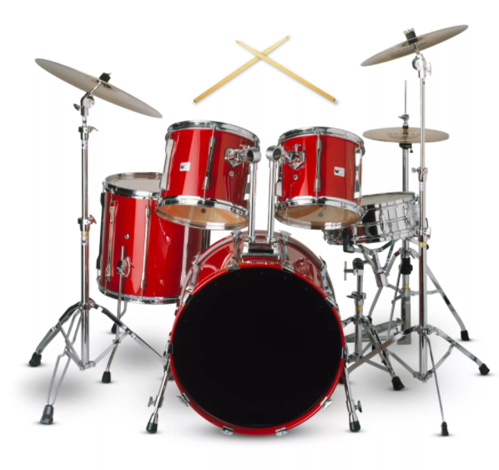
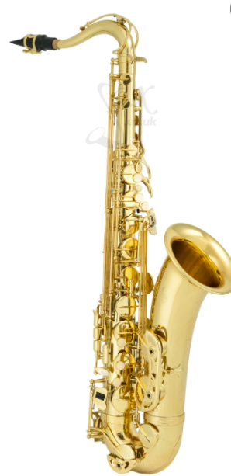
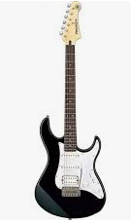
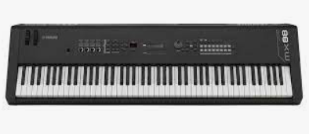
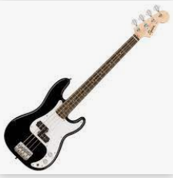
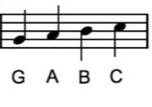
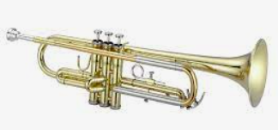
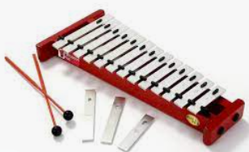
Syncopation: Music with lots of rhythmic variety, often quite difficult. The strong beats occur in unexpected places
Whitley Abbey Primary School
Hand in Hand We Learn
Knowledge Organiser - Music - Key stage 1
Key Vocabulary
Pulse - is a steady beat like a ticking clock or your heartbeat.
Rhythm - is the pattern of long and short sounds as you move through the song.
Pitch - is how high or low a note sounds.
Rap - rhythmic, rhyming speech.
Compose - means "putting together", so a composition is something where music notes have been put together
Melody - is a group of notes of various pitches (how high or low a note sounds) which are played one after another. Together they make a tune in the same way that a group of words make a sentence.
Perform - present (a form of entertainment) to an audience.
Percussion - any instrument that makes a sound when it is hit, shaken, or scraped
Audience - spectators or listeners at a public event
Dynamics - means how quietly or loudly a piece of music should be played.
Tempo - is the speed of the underlying beat.
Improvise - is the art of playing an instrument (or singing) in which the musician or musicians make up the music as they play.
Drums
Saxophone
Keyboard
Bass Guitar
Electric Guitar
Rocking Horse
Yo-Yo
Glockenspiel
Trumpet
Blues | Baroque | Folk | Funk | Nova | Reggae
A style of music characterised by its harmonic structure and the notes used to create the melodies. | long flowing melodic lines often using ornamentation (decorative notes such as trills and turns) contrast between loud and soft, solo and ensemble. | Music sung or played by people, usually not recorded or performed. Often the music is passed down through families and friends. | Funk: music with strong bass lines and a heavy syncopated beat. Funk music also possesses a distinctive groove, or sense of rhythmic movement that makes you want to get up and dance. | A Brazilian dance music that has syncopated guitar rhythms. | Developed in the 1970s and originated from Jamaica, Reggae defined by Bob Marley. It has a prominent bass beat and a strong off-beat usually played on the guitar.

Slide 2
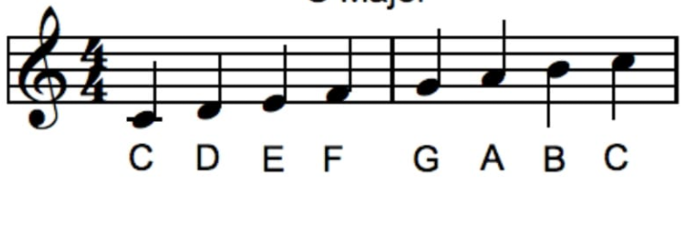
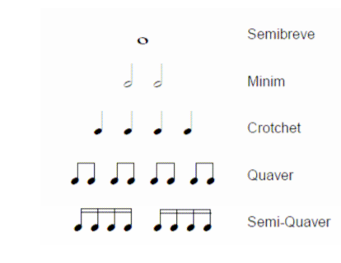
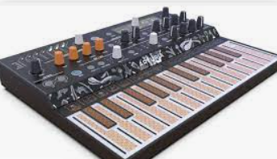
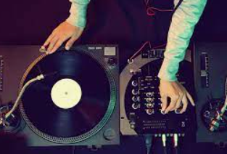
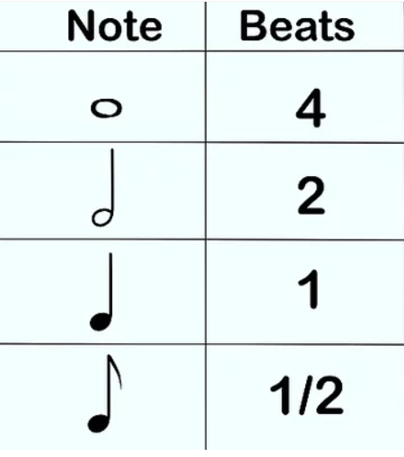
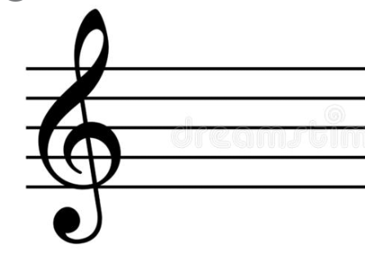
Syncopation: Music with lots of rhythmic variety, often quite difficult. The strong beats occur in unexpected places
Whitley Abbey Primary School
Hand in Hand We Learn
Knowledge Organiser - Music - Lower Key Stage 2
Key Vocabulary
Rhythm - is the pattern of long and short sounds as you move through the song.
Pitch - is how high or low a note sounds.
Verse - is a repeated section of a song that typically features a new set of lyrics on each repetition.
Chorus - part of a song that is repeated several times, usually after each verse
Hook - is a musical idea, often a short riff, passage, or phrase, that is used in popular music to make a song appealing and to "catch the ear of the listener".
Texture - texture is how the tempo, melodic, and harmonic materials are combined in a musical composition, determining the overall quality of the sound in a piece.
Riff - a repeated chord progression or refrain in music
Notation – The way that music is written down.
Compose - means "putting together", so a composition is something where music notes have been put together.
Melody - is a group of notes of various pitches (how high or low a note sounds) which are played one after another. Together they make a tune in the same way that a group of words make a sentence.
Dynamics - means how quietly or loudly a piece of music should be played.
Tempo - is the speed of the underlying beat.
Improvise - is the art of playing an instrument (or singing) in which the musician or musicians make up the music as they play.
solo - written for performance by one singer or instrumentalist
Synthesiser
Turntables
Stave
R and B | Grime | Soul | Gospel
music that is rhythmic and has the soulful achings of the blues. | Electronic dance music that emerged in London in the early 2000s. It developed out of a British electronic music style called UK Garage, and draws influences from Jungle, Dancehall, and Hip Hop. It has been described as the "most significant musical development within the UK for decades.” | a kind of music incorporating elements of rhythm and blues and gospel music | Music that is Christian usually sung with rich harmony and often with a call and response structure.

Slide 3
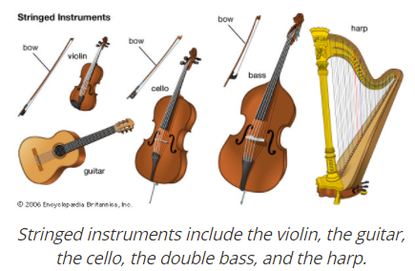
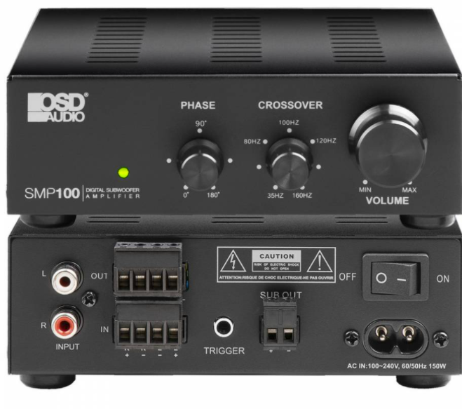
Syncopation: Music with lots of rhythmic variety, often quite difficult. The strong beats occur in unexpected places
Whitley Abbey Primary School
Hand in Hand We Learn
Knowledge Organiser - Music - Upper Key Stage 2
Key Vocabulary
Rhythm - is the pattern of long and short sounds as you move through the song.
Pitch - is how high or low a note sounds.
Verse - is a repeated section of a song that typically features a new set of lyrics on each repetition.
Chorus - part of a song that is repeated several times, usually after each verse
Hook - is a musical idea, often a short riff, passage, or phrase, that is used in popular music to make a song appealing and to "catch the ear of the listener".
Texture - texture is how the tempo, melodic, and harmonic materials are combined in a musical composition, determining the overall quality of the sound in a piece.
Riff - a repeated chord progression or refrain in music
Notation – The way that music is written down.
Compose - means "putting together", so a composition is something where music notes have been put together.
Melody - is a group of notes of various pitches (how high or low a note sounds) which are played one after another. Together they make a tune in the same way that a group of words make a sentence.
Dynamics - means how quietly or loudly a piece of music should be played.
Tempo - is the speed of the underlying beat.
Ballad - slow sentimental or romantic song.
Interlude - an interlude is an instrumental passage that comes between sections of lyrics in a song,
Bridge - a bridge is a contrasting section that prepares for the return of the original material section.
Amplifier
Turntables
Stave
Rock | Swing | Neo soul | Jazz | Motown
Came from Rock’n’roll of America in the 1950s and 1960s. It is characterised by loud guitars and drums due to the heavy amplification, strong bass line and driving rhythms. | A type of rhythm often associated with Jazz. Notes in the rhythm pattern are made longer and shorter to create a syncopated effect. | The style emerged from Soul and contemporary RnB. The instrumentation, arrangement and studio mix are very important. Songs are mixed in the studio to sound as if they are from an older Soul era like the Motown era. The modern way in which the songs are produced, give a timeless Soul feel that has a contemporary edge. | American music developed especially from ragtime and blues and characterized by propulsive syncopated rhythms, polyphonic ensemble playing, varying degrees of improvisation, and often deliberate distortions of pitch and timbre. | A 1960s label created from Soul music characterised by a rhythm section playing, laying down the groove with a funky bassline and a tambourine sounding over the top. Often brass sections play punchy riff-based rhythms and sometimes violins playing long high notes.

