Slide 1
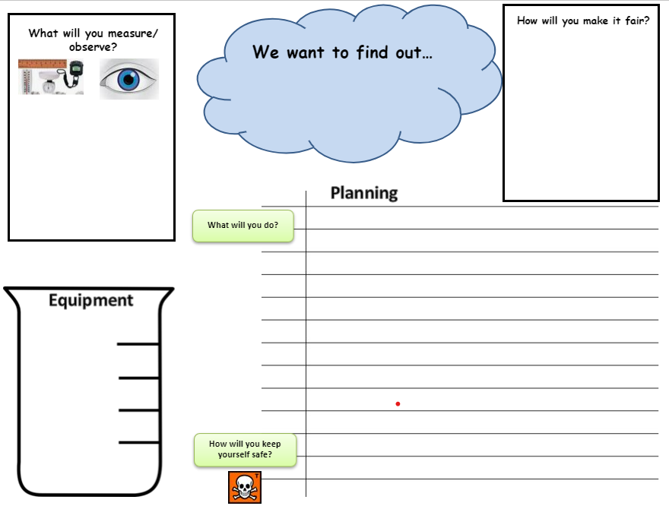
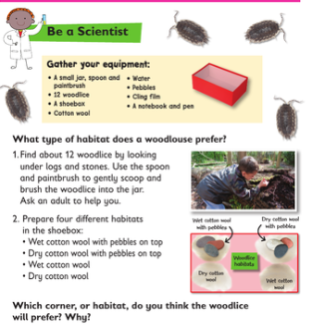
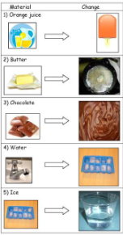
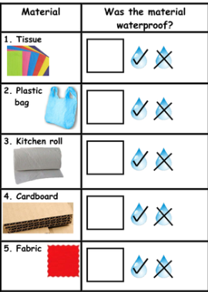
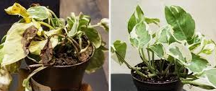
KS1 Vocabulary
Question
Find out
Observe
Describe
Test
Compare
Measure (length, height, mass, time, temperature)
Record
Results
Table
Chart
Pictogram
Block Graph
Bar chart
Whitley Abbey Primary School
Hand in Hand We Learn
Knowledge Organiser – Investigations KS1
Possible Investigations
Asking Questions | Predict | Set up tests | Observe and Measure | Record Data | Interpret Results | Evaluate

Slide 2
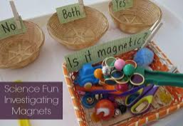
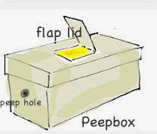
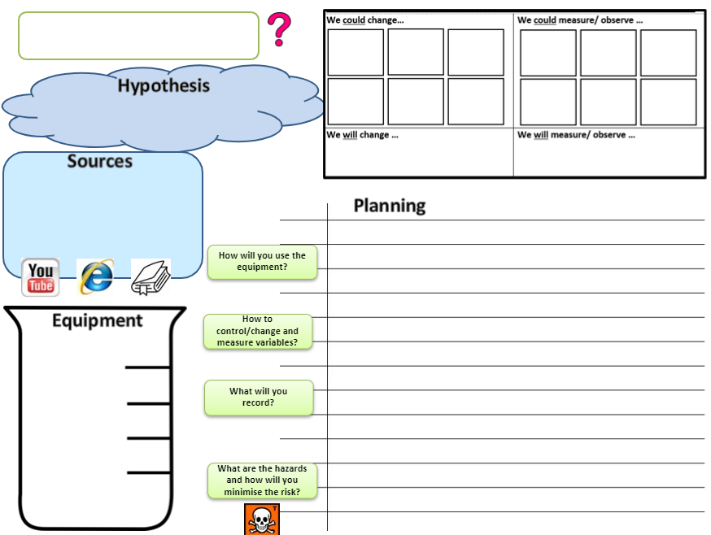
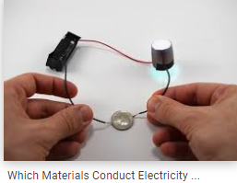
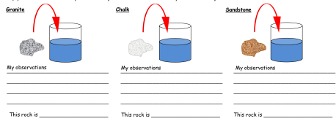
LKS2 Vocabulary
Observe
Measure
Record
Chart
Graph
Evidence
Hypothesis
Prediction
Enquiry
Fair Test
Variable
Research
Equipment
Gather
Classify
Present
Diagram
Sources
Whitley Abbey Primary School
Hand in Hand We Learn
Knowledge Organiser – Investigations LKS2
Possible Investigations
Hypothesis
It is a tentative explanation for an observation, phenomenon, or scientific problem that can be tested by further investigation.
Asking Questions | Predict | Set up tests | Observe and Measure | Record Data | Interpret Results | Evaluate

Slide 3
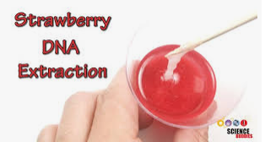
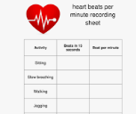
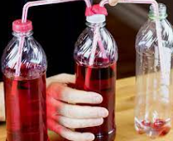
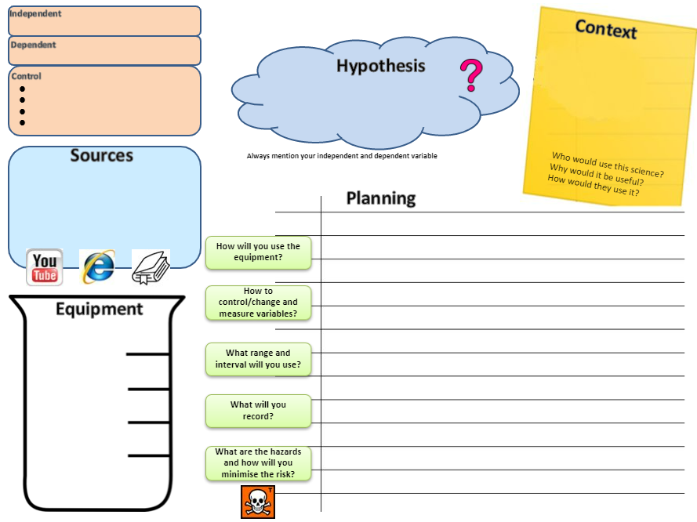
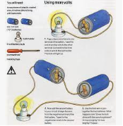
UKS2 Vocabulary
Observe
Measure
Record
Data
Chart
Graph
Evidence
Hypothesis
Prediction
Fair test
Variable
Dependant variable
Independent variable
Experiment
Theory
Conclusion
Analysis
Findings
Context
Equipment
Sources
Whitley Abbey Primary School
Hand in Hand We Learn
Knowledge Organiser – Investigations UKS2
Possible Investigations
An independent variable is the variable that is changed or controlled in a scientific experiment to test the effects on the dependent variable.
A dependent variable is the variable being tested and measured in a scientific experiment.
Asking Questions | Predict | Set up tests | Observe and Measure | Record Data | Interpret Results | Evaluate

