Slide 1
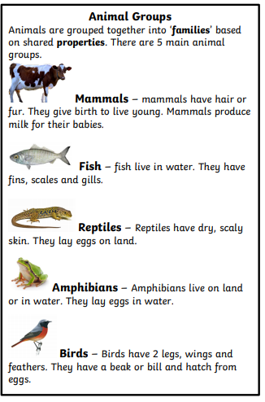
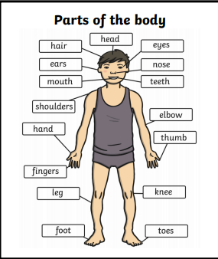
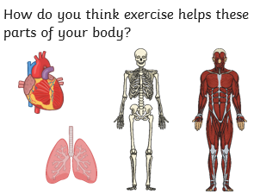
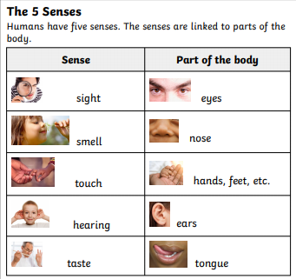
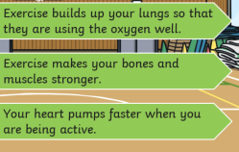
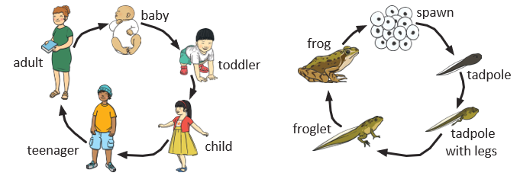
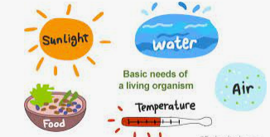
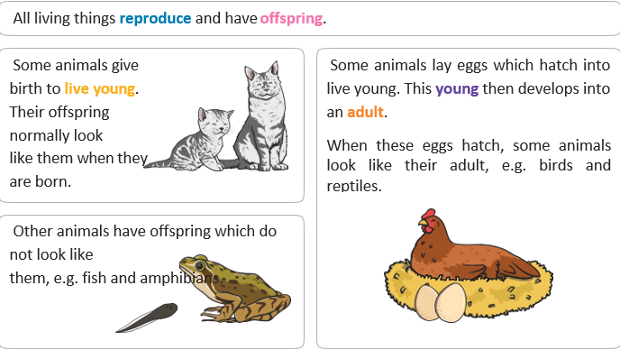
Whitley Abbey Primary School
Hand in Hand We Learn
Knowledge Organiser - Science – Animal Including Humans 1/2

Slide 2
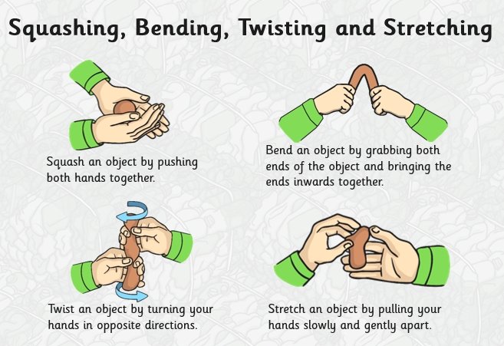
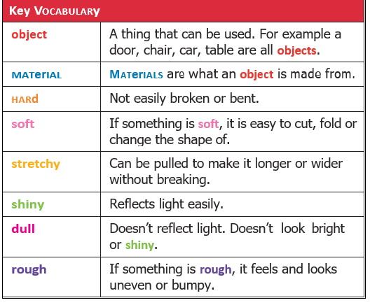
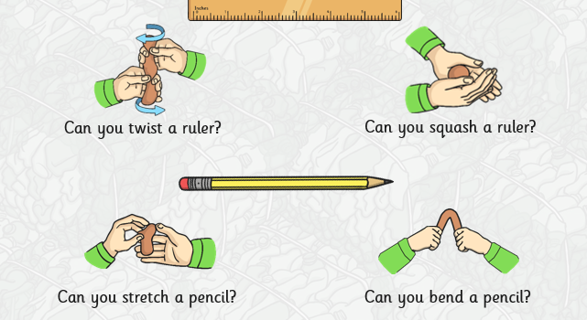
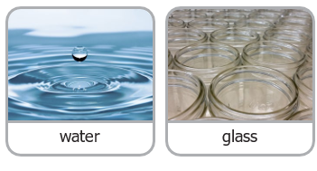
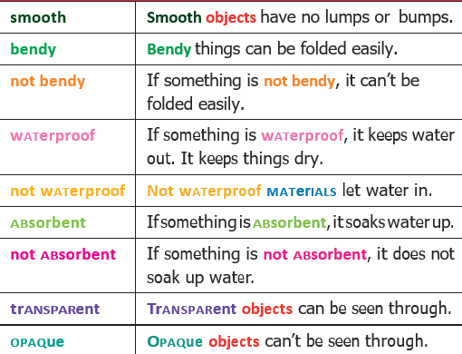
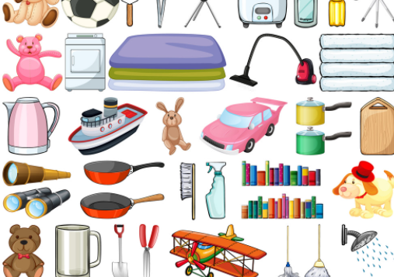
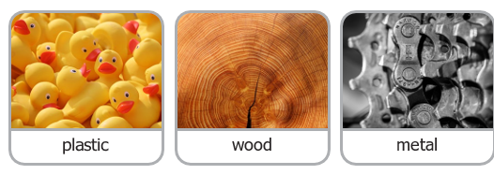
Whitley Abbey Primary School
Hand in Hand We Learn
Knowledge Organiser - Science Materials and their properties –1/2

Slide 3
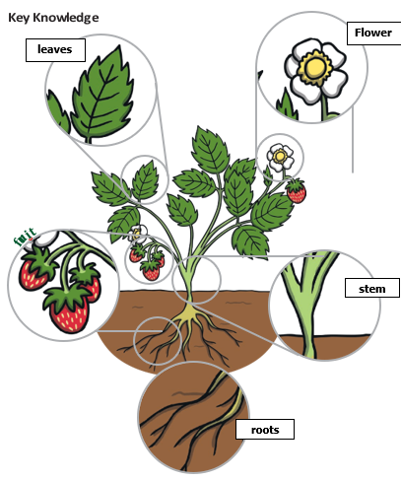
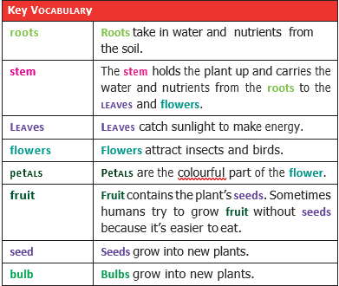
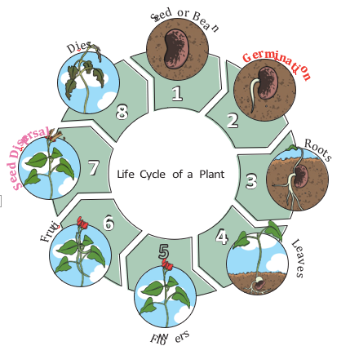
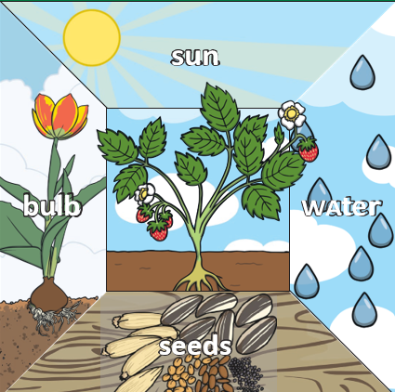
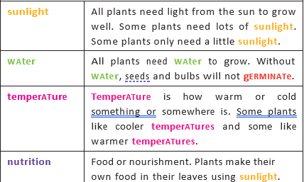
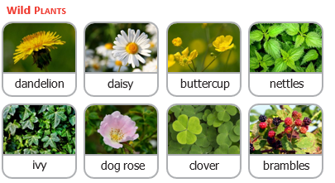
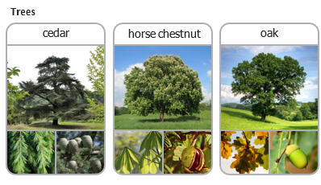
Whitley Abbey Primary School
Hand in Hand We Learn
Knowledge Organiser - Science – Plants –1/2

Slide 4
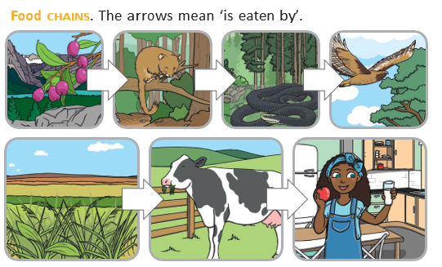
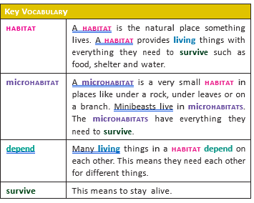
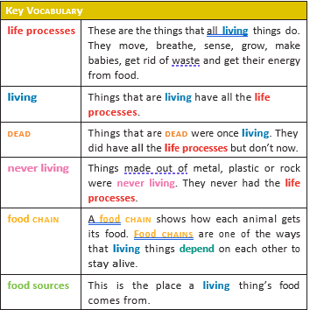
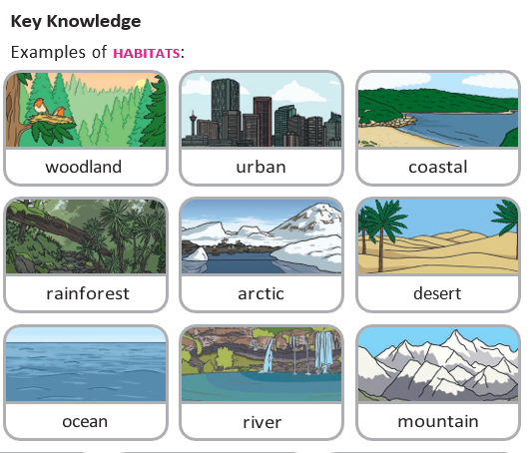
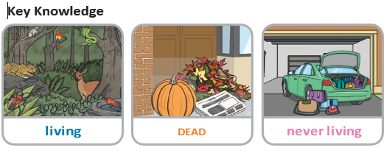
Whitley Abbey Primary School
Hand in Hand We Learn
Knowledge Organiser - Living Things and habitats –1/2

Slide 5
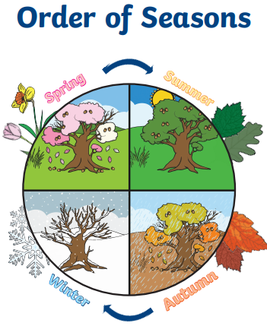
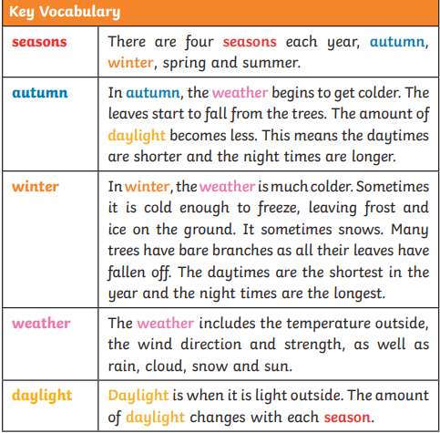
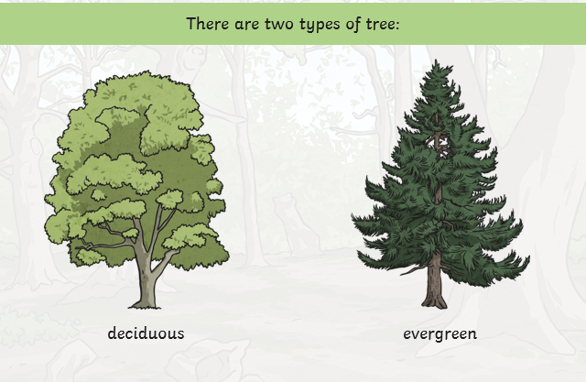
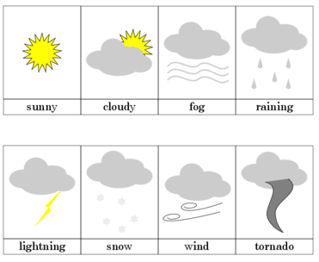
Whitley Abbey Primary School
Hand in Hand We Learn
Knowledge Organiser - Seasons–1/2

Slide 6
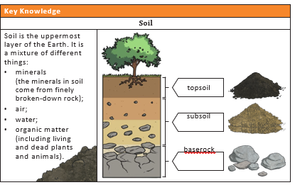
Whitley Abbey Primary School
Hand in Hand We Learn
Knowledge Organiser - –Rocks - 3

Slide 7
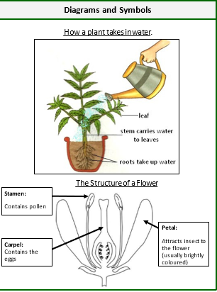
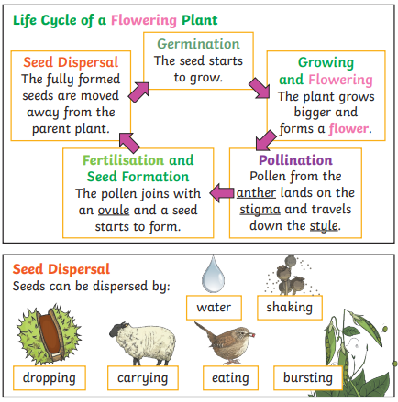
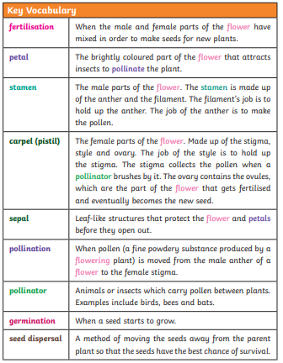
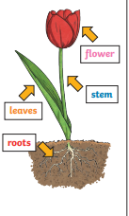
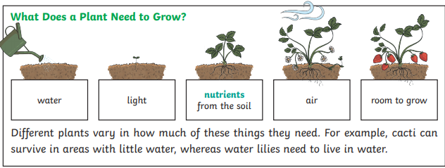
Whitley Abbey Primary School
Hand in Hand We Learn
Knowledge Organiser - –Plants - 3

Slide 8
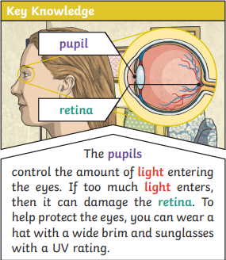
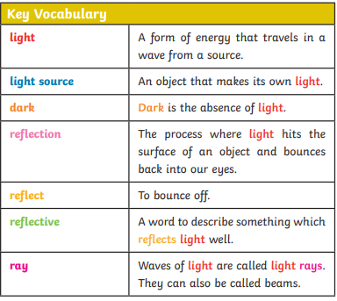
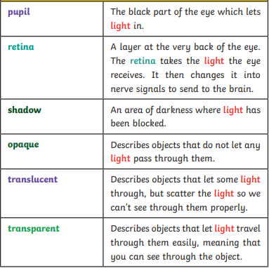
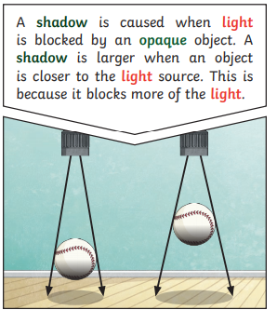
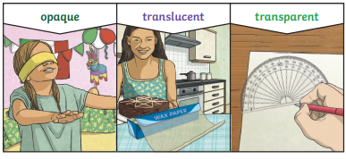
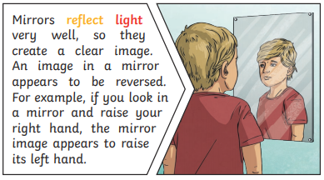
Whitley Abbey Primary School
Hand in Hand We Learn
Knowledge Organiser - Light– 3

Slide 9
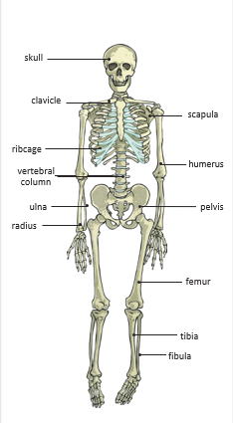
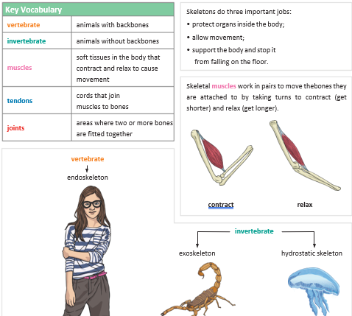
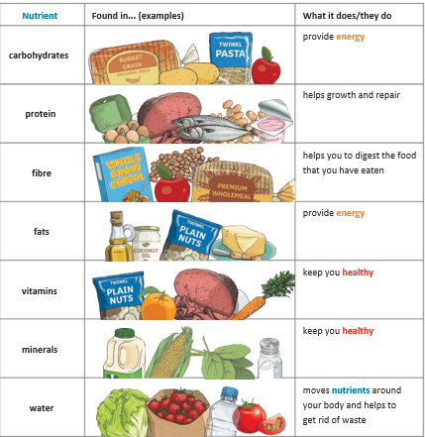
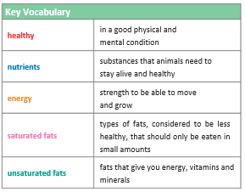
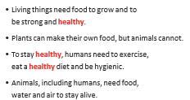
Whitley Abbey Primary School
Hand in Hand We Learn
Knowledge Organiser - Animals Including Humans– 3

Slide 10
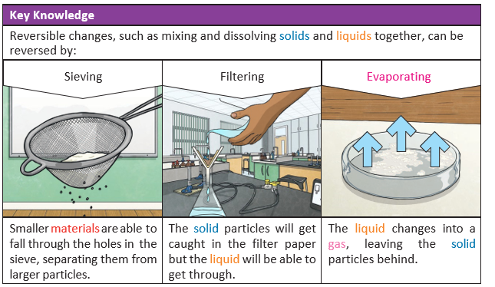
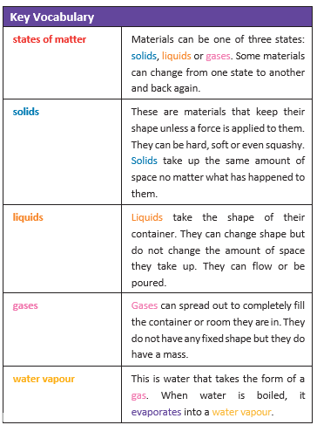
Whitley Abbey Primary School
Hand in Hand We Learn
Knowledge Organiser –States of Matter – 4/5

Slide 11
Whitley Abbey Primary School
Hand in Hand We Learn
Knowledge Organiser –Animals and humans– 4

Slide 12
Whitley Abbey Primary School
Hand in Hand We Learn
Knowledge Organiser –Animals and humans– 5

Slide 13
Whitley Abbey Primary School
Hand in Hand We Learn
Knowledge Organiser –Electricity– 4

Slide 14
Whitley Abbey Primary School
Hand in Hand We Learn
Knowledge Organiser –Sound – 4/5

Slide 15
Whitley Abbey Primary School
Hand in Hand We Learn
Knowledge Organiser –Living Things – 4/5

Slide 16
Whitley Abbey Primary School
Hand in Hand We Learn
Knowledge Organiser –Earth and Space – 5

Slide 17
Whitley Abbey Primary School
Hand in Hand We Learn
Knowledge Organiser –Forces– 5

Slide 18
Whitley Abbey Primary School
Hand in Hand We Learn
Knowledge Organiser ––Evolution and Inheritance 6

Slide 19
Whitley Abbey Primary School
Hand in Hand We Learn
Knowledge Organiser –– Electricity - 6

Slide 20
Whitley Abbey Primary School
Hand in Hand We Learn
Knowledge Organiser –– Light - 6

Slide 21
Whitley Abbey Primary School
Hand in Hand We Learn
Knowledge Organiser –– Living things and habitats - 6

Slide 22
Whitley Abbey Primary School
Hand in Hand We Learn
Knowledge Organiser –– Animals Including humans - 6

